Slide 1
Radium sorption to iron minerals
Michael Chen, Tiffany Wang, Benjamin Kocar
MIT Department of Civil and Environmental Engineering
ACS National Meeting and Exhibition Boston
August 20th, 2015
Notes:
Good morning, my name is Michael Chen, and I’ll be presenting some results from our lab’s work on radium sorption to iron minerals.

Slide 2
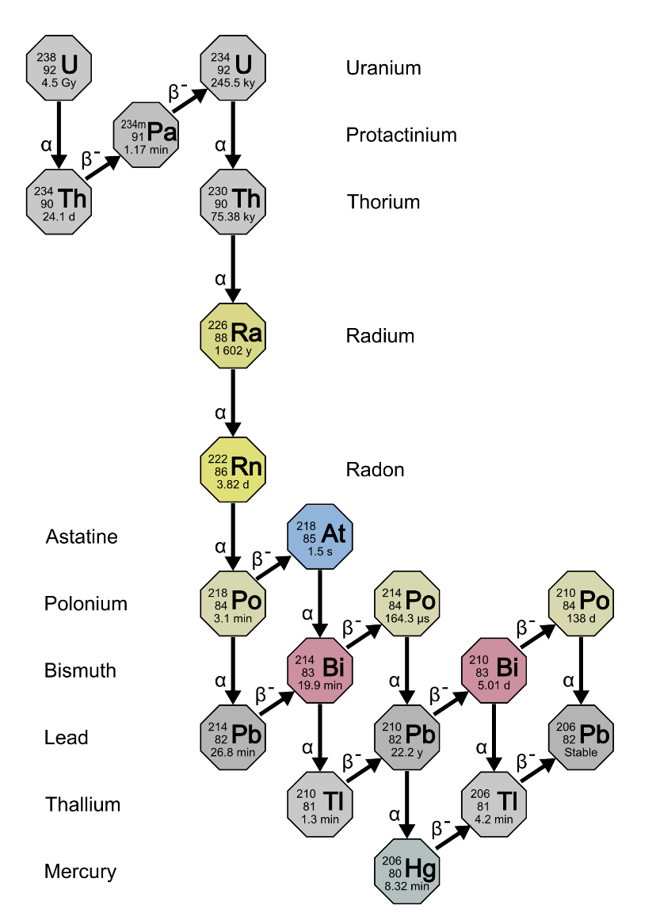
Introduction and objectives
Naturally occurring radium isotopes
Natural hazard/tracer with little human use
Wide range of half lives and simple chemistry
3 days – 1600 years
Goal: Understand geochemistry for better predictions of transport
This talk: Sorption isotherms
Uranium Series decay taken from en.Wikipedia.org/Decay_chain
Notes:
Radium isotopes are naturally occurring radioactive materials that are generated in the ground surface. While they have seen historic use as a luminescent compound and dubiously safe “medicine,” there is little current anthropogenic use. At present there they represent a natural hazard when brought to the surface by anthropogenic activities such as natural gas extraction, and as generators of radon, which can accumulate in buildings with poor ventilation. They also have seen some use recently as natural tracers for groundwater flow. The naturally abundant radium isotopes have a range of half lives from a few days, to 1600 years, presenting both a long term hazard but also a broad range of timers for natural processes. Radium has only two oxidation states, the two plus state and zero valent metal, thus transport is generally simpler, dominated primarily by sorption reactions with minerals. In spite of this simplicity, radium transport remains poorly understood as compared to other contaminants such as Uranium or Arsenic. Our goal is to improve understanding of radium geochemistry in support of building better predictions of radium transport.

Slide 3
Radium in the environment
Ubiquitous generation in ground surface by Source: ubiquitous parent radionuclides
Removal dominated by advection and decay
Strong adsorption to iron and manganese minerals
Tracer usage
Notes:
Environmental radium is generated from the decay of solid uranium and thorium that is well distributed in the ground surface. In regions with low groundwater flux, deep pore waters are enriched with radium isotopes reaching a steady state that matches the relative ratios of the parent products, while shallower regions see groundwater flux that eventually deposits radium into the ocean, where it the isotopes are removed by decay. With strong adsorption retarding transport and exclusive generation in the ground surface, radium is a relatively persistent compound which only sees decrease in the ocean, where decay removes radium from the water column. Radium traditionally is seen as a compound with high retardation factors, owing to strong sorption by iron and manganese minerals, so transport is expected to be relatively slow compared to other compounds.

Slide 4
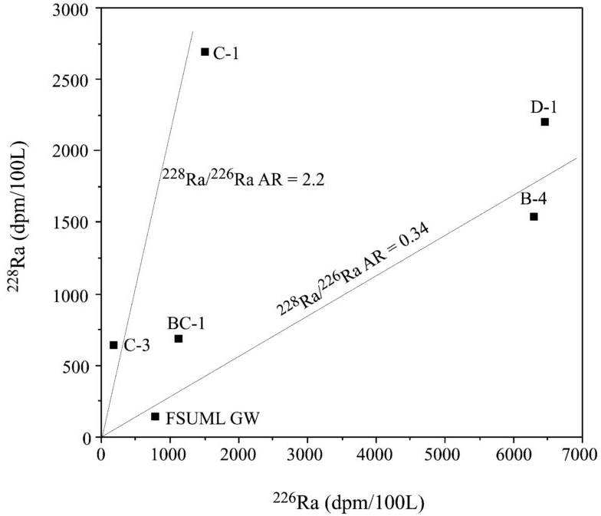
Radium as groundwater flux tracer
Radium isotope mixing model for nearshore system
Source:
Groundwater
Sink:
Decay
Assumes conservative transport (of Ra isotopes?)
Figure from Moore, 2003, illustrating the identification of radium sources for a nearshore system.
Notes:
In recent years, naturally occurring radium has been leveraged as a natural tracer of opportunity. The radium isotope method estimates groundwater flux into the ocean through radium isotope ratios. In the method, groundwater sources are characterized by their isotopic ratio, and then oceanic isotope measurements are matched to those sources through a mixing model. The model assumes conservative radium transport, attributing isotope sources to specific groundwaters and the only sink for isotopes as decay. The figure on the right, which comes from Moore, 2003, illustrates one of the steps of this process. The radium 226 and radium 228 concentrations of oceanic and groundwater samples in an estuarine system are plotted together, revealing two distinct slopes that can be tied to specific groundwater sources of radium.
The estimates by these methods have been matched to a variety of other methods, and is accurate for a region so long as the groundwater sources are all accounted for. Because the method does not resolve groundwater transport however, any fractionation that might occur due to decay, as radium 228 decays through insoluble thorium before decaying into radium 224. This has not historically been a problem for these estimations, but the accuracy and predictive power of these models would be improved with a better understanding of radium geochemical behavior.

Slide 5
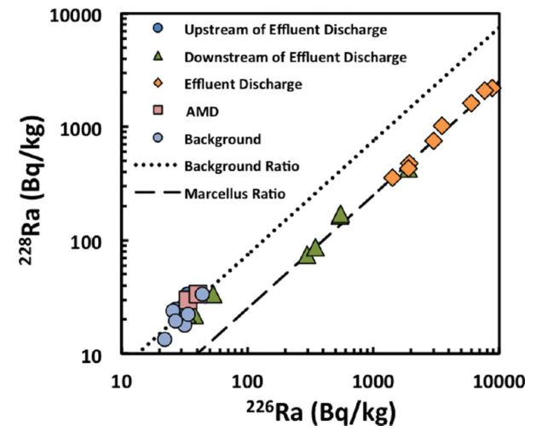
Radium in hydraulic fracturing
Produced water brings radium to surface
Treatment/disposal expensive
Co-precipitation with Barium Sulfate
Improper handling can lead to leakage
Potential to mark contamination events
Figure from Warner et al, 2013 of river sediment radium concentrations near a waste water treatment plant
Notes:
One activity where radium presents a major hazard is hydraulic fracturing where radium enriched pore waters are brought to the surface along with extracted natural gas. Activities of radium can exceed VALUE, presenting a radioactive hazard to workers and the local ecosystem that is expensive to address. Extremely saline produced waters are often either treated on site, where radium is removed by either filtration through manganese oxide filters or by co-precipitation with Barium Sulfate. In cases where treatment is too expensive, the produced water is transported away from sites to be disposed in deep geologic formations. The primary risk of leakage for radium contamination occurs before treatment, when produced water has to be stored on site and above ground. Storage ponds used for this purpose may not necessarily be sealed properly, and produced water can be leaked to the shallow subsurface.
A recent study examining the river sediments near a produced water treatment plant found that river sediments downstream had the same isotopic ratio as materials from the Marcellus shale. Given the high retention, and clear difference in isotopic signature, it may be possible to trace historic contamination events by monitoring radium isotopes. This would only be possible by a solid understanding of radium behavior in the subsurface.

Slide 6
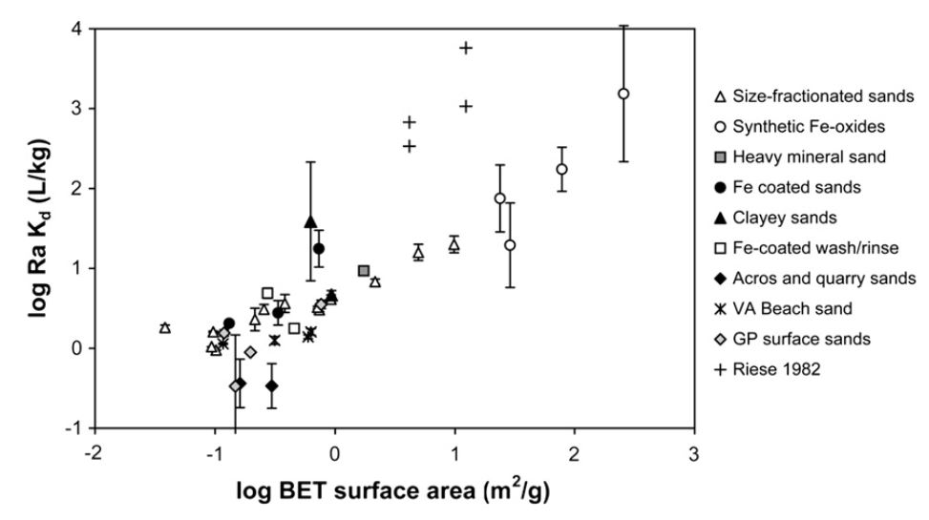
“Historical” data: large variability
DATA SLIDE
Radium sorption to marine sands in seawater from Beck & Cochran, 2013
Notes:
Compared to other contaminants and tracers, there has been relatively sparse characterization of radium adsorption, with significantly differing results. This figure, which shows the log BET surface area of the adsorbent vs the Kd for radium comes from a review of radium adsorption to marine sands from 2013, showing a wide range of linear Kd values for radium sorption to various materials. In particular, I’d like to highlight the large variation of Kd values both within a single type of material, as well as across materials with similar BET surface area. Generally, oxidized iron minerals have stronger sorption, but a mechanistic understanding of this behavior has only recently seen any attention. One of our goals here is to improve that understanding.

Slide 7
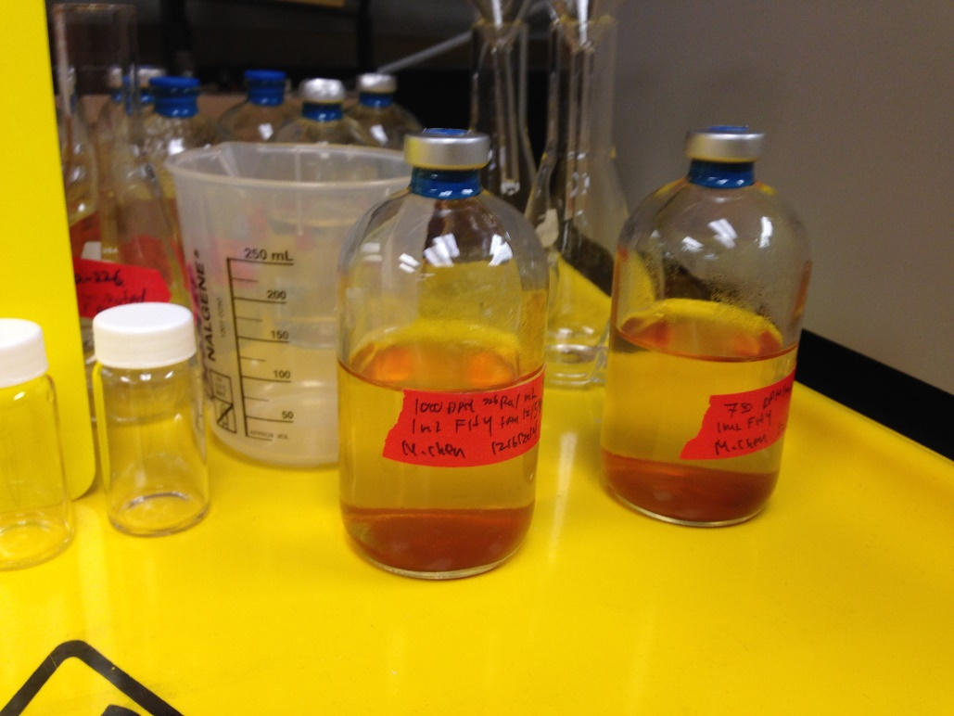
Experimental Methodology
Synthesized Ferrihydrite, 12 mg in solution
Acid washed, 44-250 um pyrite, 20 mg
24 hour shaking time with 100 mL pH adjusted milliQ water
3000 to 50000 DPM total activity
Radium 226 counted with Scintillation Counter
Two serum vials after a sorption isotherm experiment
Notes:
At present, we have conducted sorption experiments for radium to two minerals: ferrihydrite and pyrite. The ferrihydrite is synthesized by our lab, and aliquots containing 4 mg iron as ferrihydrite are added. Pyrite is sieved to 44-250 um, acid washed to remove oxic coatings, and stored in an anaerobic chamber. In these experiments we add 20 mg of pyrite (which corresponds to 9 mg of Fe as pyrite). These minerals are added to radium containing solutions which are pH adjusted using hydrochloric acid or sodium hydroxide as necessary, with a final volume of 100 mL. Total activities of radium 226 added to these bottles cover from around 3000 DPM to 50000 DPM. After moderate shaking for 24 hours, we note the final pH of the solution, and scintillation count the supernatant. Solid sorption concentrations are then found by mass balance of radium.

Slide 8
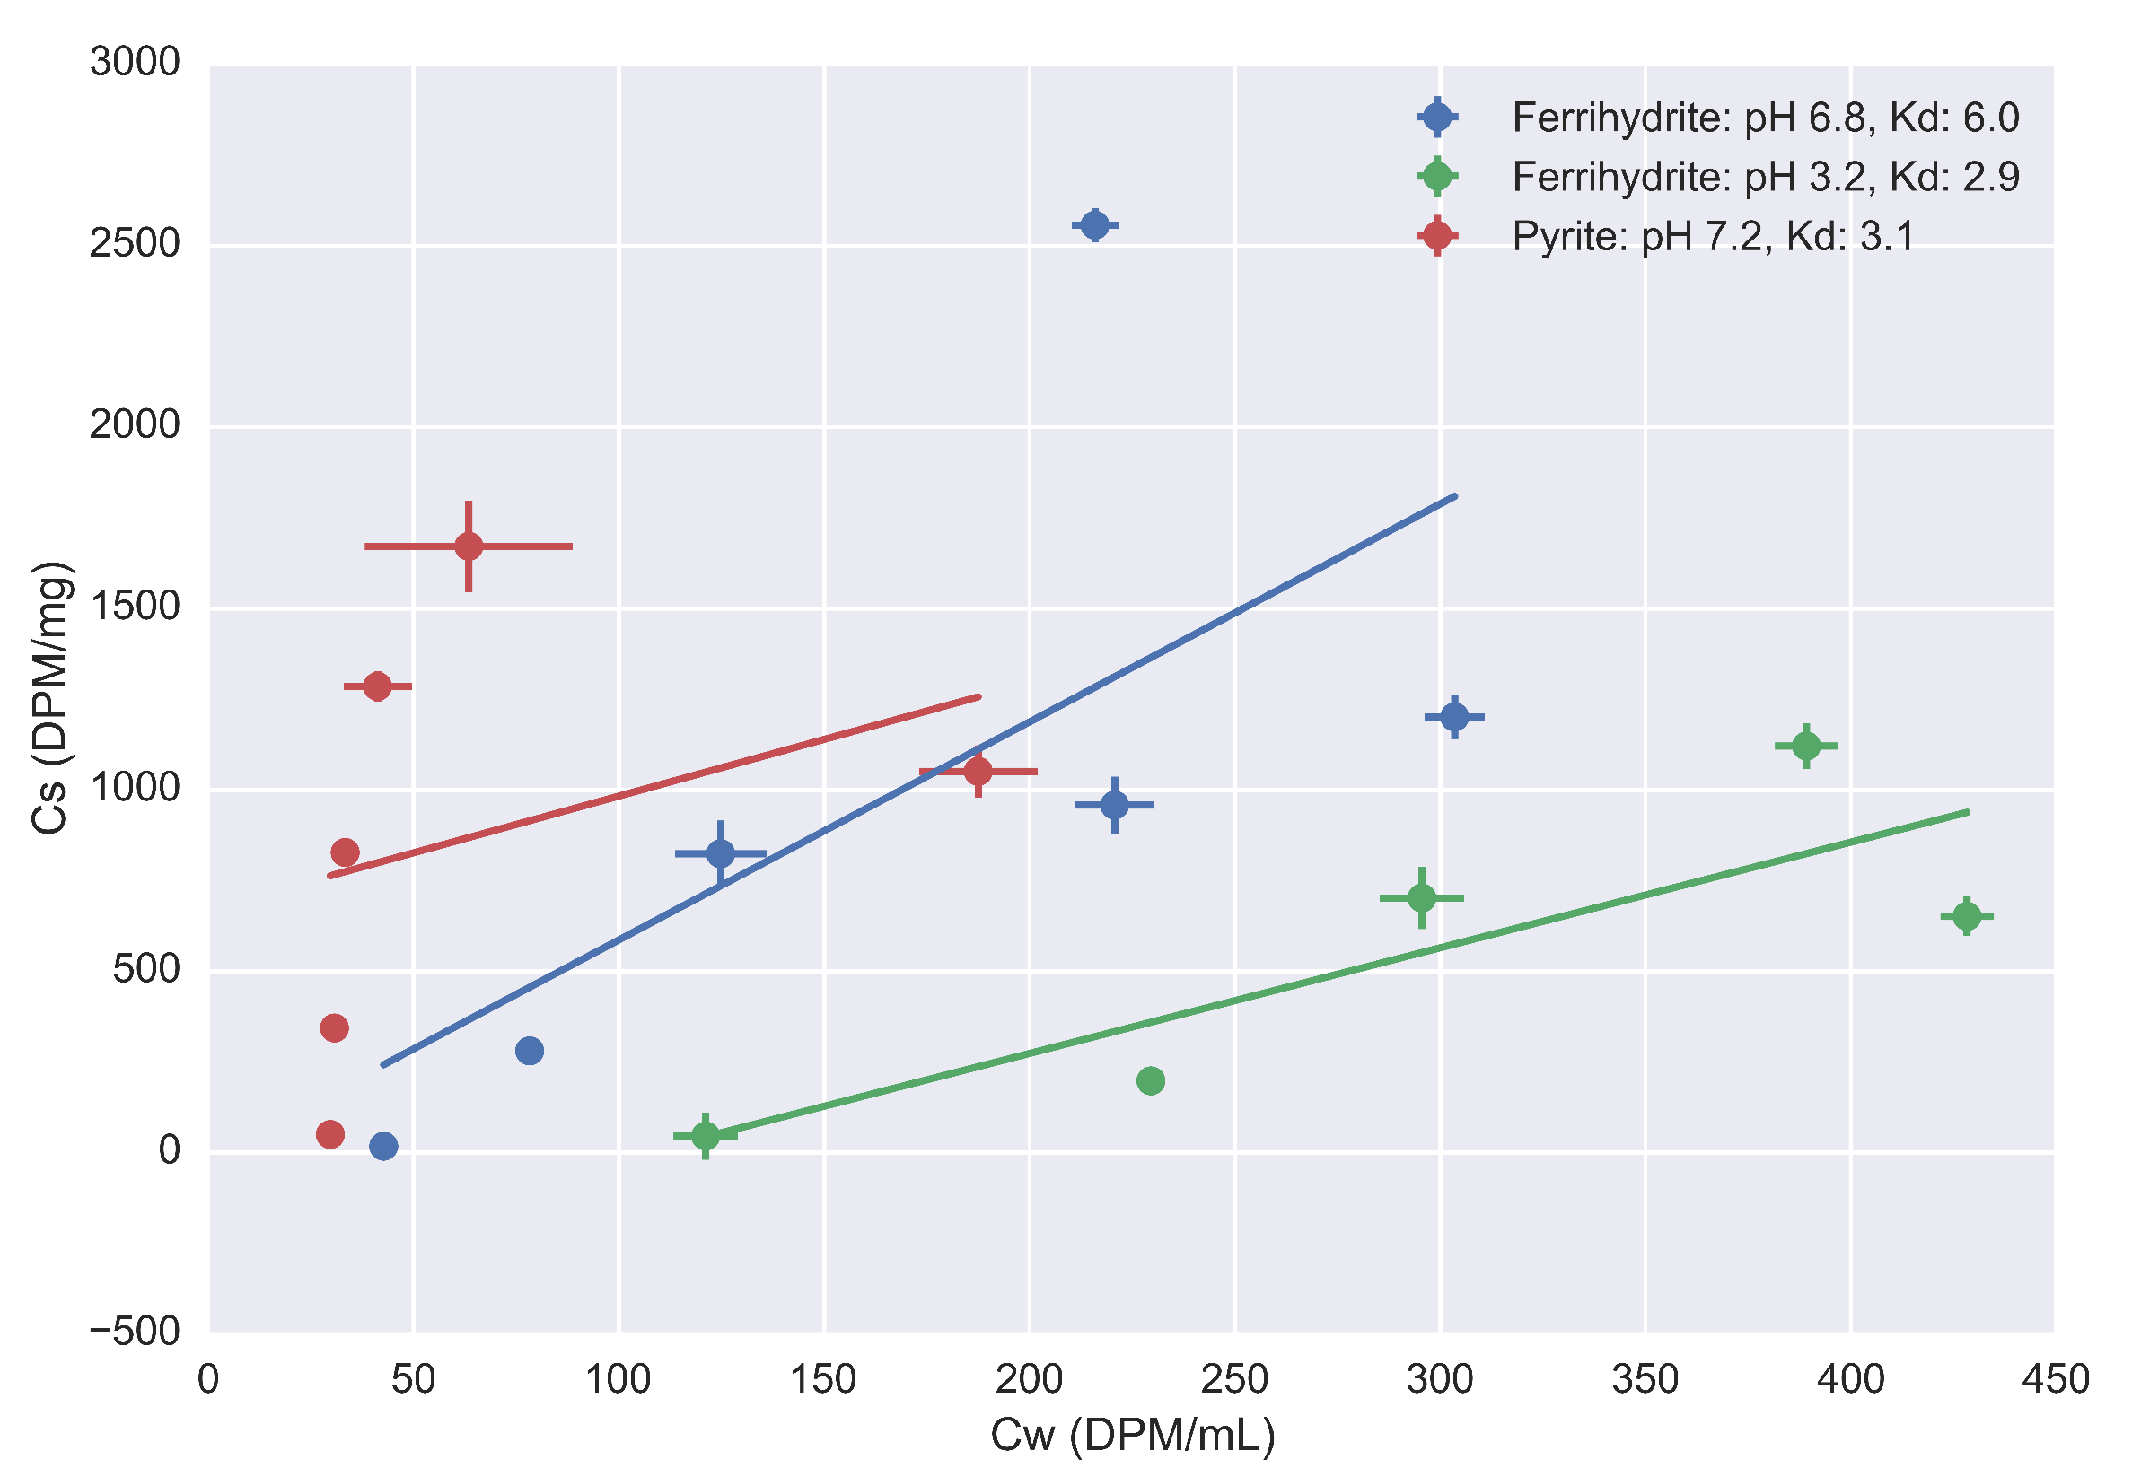
Notes:
Here we plot water activities vs adsorbed solid activities for controlled pH experiments, with data points in triplicate as dots with error lines. Lines are linear regression fits using the scipy package. The blue and green colors represent Ferrihydite, with pH values of 6.8 (plus/minus 0.2), and 3.2 (plus/minus 0.1). The data points and line in red are for pyrite at an average pH of 7.2 (plus/minus 0.2). The fit for the circumneutral isotherms have some spurious points, which we plan to run again to clarify the result. The fits will also be improved as these points are run again.
What is interesting to note here is that pyrite has a similar range of total activities, but has similar or stronger sorption behavior. Pyrite is generally considered a weaker adsorbent than ferrihydrite due to its lower surface area, but this does not seem the case here. One possibility is that the pyrite surface sites have stronger affinity for radium in its plus 2 state as compared to ferrihydrite. The other interesting trend to note is that ferrihydrite has lower adsorption at lower pH values.

Slide 9
Isotherm discussion
Ferrihydrite:
Low pH has lower sorption
Pyrite:
Stronger adsorption than ferrihydrite at same pH
Data points in need of clarification

Slide 10
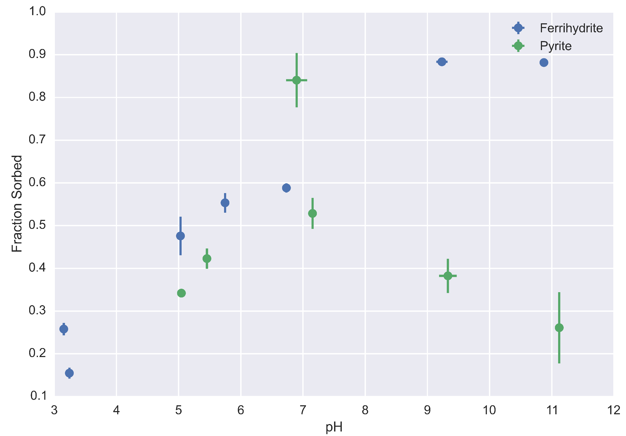
Notes:
This figure shows data for radium adsorption with total activities around 50000 DPM for FHY and 40000 DPM for PYR. pH is on the horizontal axis, and fraction sorbed is on the vertical axis.
The trend we saw in the isotherm data for ferrhydite is maintained here, with ferrihydrite adsorption increasing with increasing pH. However, it reaches a maximum around pH 9. This trend has been found in previous studies of ferrihydrite sorption. In constrast, pyrite behavior is more complex, with minimal adsorption occurring at extreme pH values, and maximal sorption at circumneutral pH. As previously mentioned, some of the data points here are unclear, and may need to be rerun. One reason that pyrite adosprtion decreases with increasing pH, but FHY adsorption increases could be that FHY adsorption is more thermodynamically favorable for radium and ferrihydrite than radium and pyrite at higher pH values. This may be driven by the formation of radium hydroxide complexes.

Slide 11
Discussion
Ferrihydrite:
Increasing adsorption with increasing pH, matching isotherm results
Adsorption peaks out
Pyrite:
Maximal sorption at circumneutral pH

Slide 12
Preliminary Oxidation Experiment (why?)
Pyrite experiment after shaking period
Removal of supernatant for quantification
Addition of 3% hydrogen peroxide
Shaking for 48 hours with controls
Notes:
After we ran the experiment that generated the majority of the pH sweep data, we performed a preliminary experiment looking at the impacts of oxidation. We removed 10 mL of solution for radium quantification and final pH measurement. In one set of bottles we added 10 mL of 3% Hydrogen Peroxide. In the other, we left the bottle undisturbed. Both bottles were then shaken for ~60 hours, and then sampled in a similar behavior as before, checking the final pH and radium content of the filtered supernatant.

Slide 13
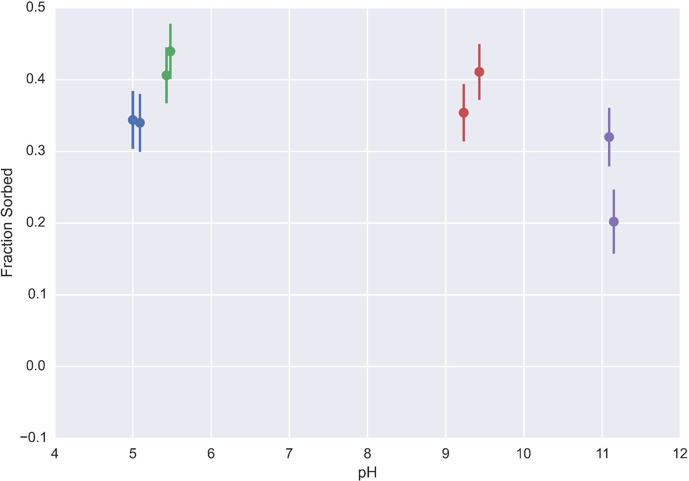
Oxidation Experiment: Before addition of hydrogen peroxide
Notes:
This is the initial data for the oxidation experiment, which are individual bottles taken from the experiment used to obtain pyrite pH sweep data, as previously mentioned. The different colors represent the different pairs of duplicates that were used in this oxidation experiment.

Slide 14
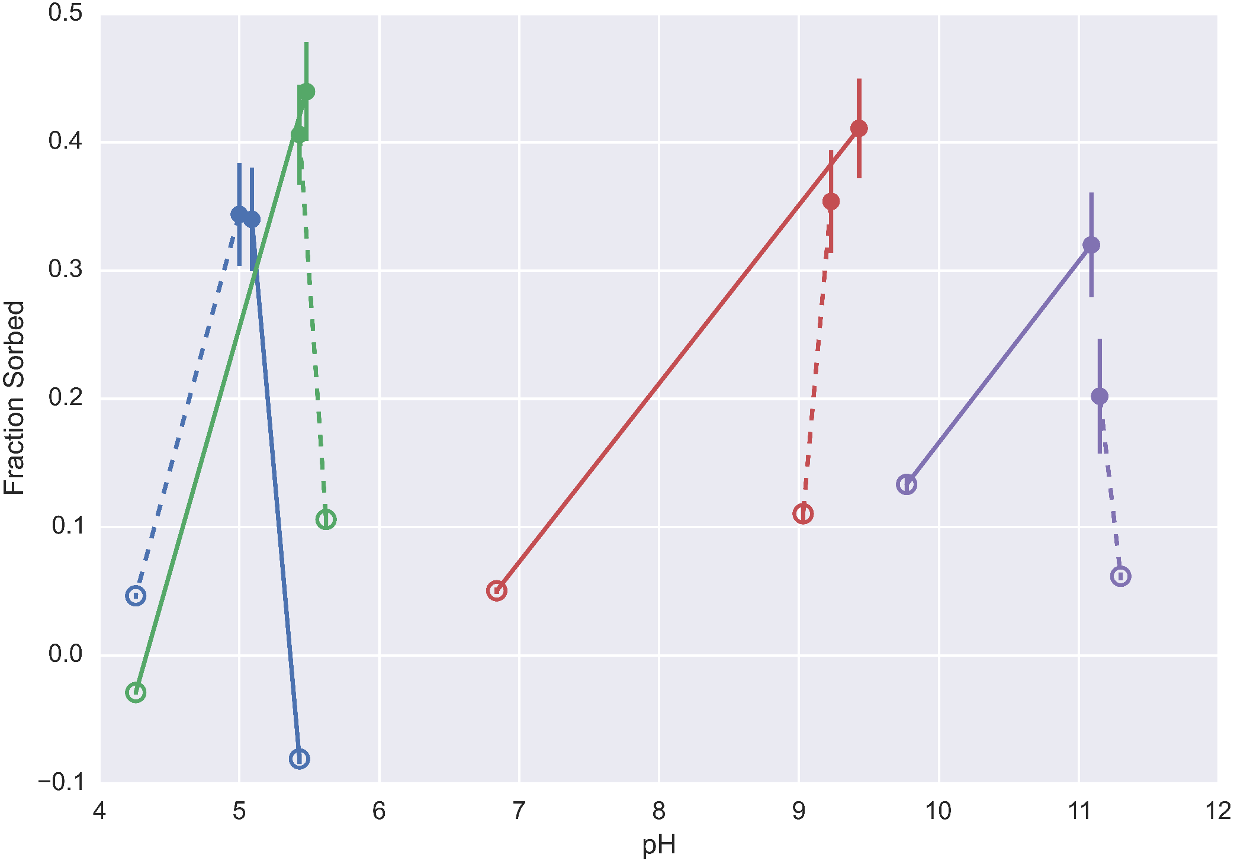
Oxidation Experiment: After hydrogen peroxide addition
Notes:
These then show what happens after the addition of hydrogen peroxide. The open circles are the post experimental data points. Dashed lines represent control experiments, where no oxidant is added. The solid lines represent systems where hydrogen peroxide is added. A few of these points have negative sorbed fractions, which are points we plan to rerun.
Looking at this graph we see the following general trends:
Total sorbed fractions decreased after the experiment.
The pH values of the oxidized experiments generally decreased, suggesting that pyrite oxidation has occurred, which would generate acid.
Addition of the oxidant has desorbed more radium than the control. Given that our data suggests pyrite might have stronger adsorption to pyrite compared to ferrihydrite, this trend also makes sense, as the oxidized coatings of the pyrite are weaker sorbents of radium.

Slide 15
Oxidation Discussion
See overall decrease in adsorption in control and experiment
General decrease in pH->change in adsorption, oxidation of pyrite
Generally more desorption with oxidant than without

Slide 16
Conclusions/Future Work
Quantified pyrite and ferrihydrite sorption behavior
Pyrite stronger sorbent than ferrihydrite
Minerals have pH dependent behavior
Further sorption experiments (salinity, minerals)
Transport experiments with columns
Impact of dynamic solution conditions
Notes:
In conclusion, we’ve been able to quantity basic trends in pyrite and ferrihydrite sorption of radium, with pyrite seeming to be the stronger sorbent. We also found pyrite has maximal sorption at circumneutral pH values, and FHY has maximal sorption at higher pH values.
For future work, we plan to expand more the range of solutions and minerals we cover, specifically addressing the impacts of increasing salinity (up toward high salinity fracking brine level), and different minerals including goethite, and other common minerals (illite, quartz sand). The next step for this work is to look at how these static behaviors change in the presence of flow through columns. Lastly, we will further explore the impacts of dynamically varying conditions in solution, particularly focusing on the impact of changes in oxidation state, and changes in salinity. These experiments will closely mirror many of the real systems that radium encounters, where anoxic waters interact with oxic waters or estuarine regions.

Slide 17
Works Cited
Beck, A. J., & Cochran, M. a. (2013). Controls on solid-solution partitioning of radium in saturated marine sands. Marine Chemistry, 156, 38–48. doi:10.1016/j.marchem.2013.01.008
Moore, W. S. (2003). Sources and fluxes of submarine groundwater discharge delineated by radium isotopes. Biogeochemistry, 66(1), 75–93. doi:10.1023/B:BIOG.0000006065.77764.a0
Warner, N. R., Christie, C. a., Jackson, R. B., & Vengosh, A. (2013). Impacts of shale gas wastewater disposal on water quality in Western Pennsylvania. Environmental Science and Technology, 47, 11849–11857. doi:10.1021/es402165b
Wikipedia. (2014, November 21). Radium. Retrieved from https://en.wikipedia.org/wiki/Radium

Slide 18
Acknowledgements
MIT Radiation Protection Office
Roman Stocker, Roberto Rusconi
Kocar Lab

